Slide 1






5.9 days
5.3 days
11 days
6 days
0 days
2021
Today
Use this demo timeline to get acquainted with Office Timeline.
Click Edit Timeline to adjust the layout by dragging & dropping elements.
Click the Edit Data button to manage your timeline items in a list format.
Use the Style Pane to customize any element on the timeline.
Preparation
75%
Feb 3 - Feb 10
Requirements
65%
Feb 10 - Feb 17
Estimation
50%
Feb 18 - Feb 25
Development
Feb 26 - Mar 13
Rollout
Mar 13 - Mar 14
Production
Mar 14
2021
Day 1
5
9
13
17
21
25
29
33
37
41
45
2021
Jan 30
Feb 25
Mar 17
Project Approval
Committee Review
Project Hand-Off

Slide 2
May 22 - Jul 30
Jul 14 - Jul 30
14 days
21 days
13 days
8 days
2021
Use this demo timeline to get acquainted with Swimlanes.
Click Edit Timeline and try dragging & dropping elements.
Project Approval
Hand-Off to Production
Apr 9, 2021
Today
Jul 30, 2021
Week 1
3
5
7
9
11
13
15
17
2021
Reviews
Mid-Cycle Review
Jun 16, 2021
Pre-Release Review
Jul 18, 2021
Requirements
Requirements
Apr 9 - Apr 28
Apr 27 - May 6
Estimation
Prototype
May 7 - Jun 5
10 weeks
Development
Production Development
50%
Deployment

Slide 3
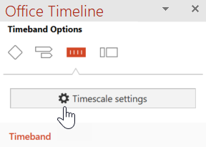
Aug 12 - Oct 22
Mar 2 - May 13
Apr 1 - Oct 21
Jun 3 - Aug 13
50.7 days
50.7 days
53 days
2021
Use this demo timeline to get acquainted with sub-swimlanes & multiple timescales.
Click Edit Timeline and try dragging & dropping elements.
Click on Timescale settings in the style pane to change timeband options.
PoC
Prototype & Alpha Build
Develop
Development
145 days
Development
Integration
Integration Phase I
Integration Phase II
Web
Beta Blog Live
Market
June 30, 2021
Press
Press Release
Public Site Live
August 2, 2021
October 20, 2021
Q1
Q2
Q3
Q4
Mar
Apr
May
Jun
Jul
Aug
Sep
Oct
2021
Week 1
6
11
16
21
26
31
Today
June 30, 2021
October 20, 2021
Public Beta
Release to Web

Slide 4
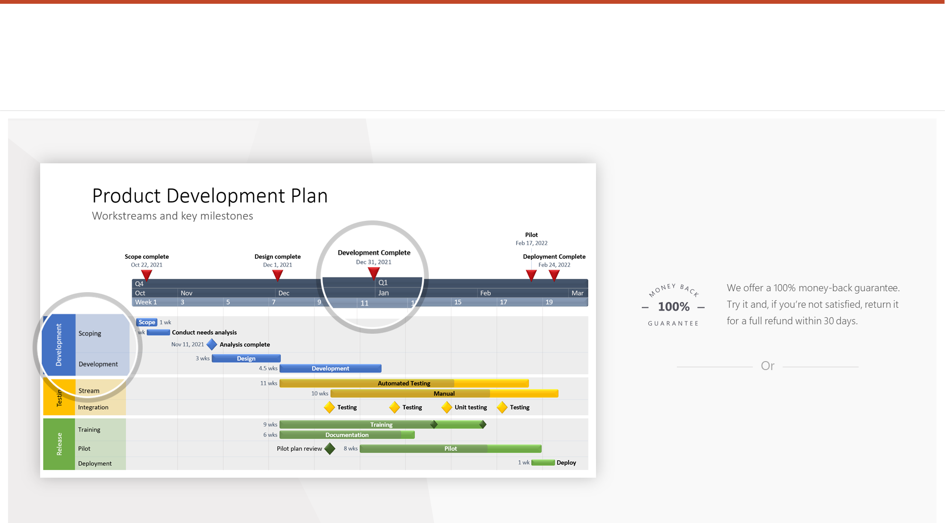
Impress your most important audiences with Pro+ slides
Office Timeline Pro+ Edition makes beautiful roadmap and program slides in minutes.
Purchase Office Timeline Pro+ Edition here: https://www.officetimeline.com/ProPlus
Schedule a free private demo here: https://www.officetimeline.com/demo

Slide 5
8 days
2 days
2022
2022
Week 1
2
3
4
2022
Today
Define the project's goals
Oct 18
Outline requirements
Oct 25
Plan the budget
Pre-Planning
Oct 27
Break down the project into tasks
Nov 1
Assign roles and responsibilities
Nov 3
Oct 27 - Nov 8
Create the project roadmap
Design Planning
Nov 8 - Nov 10
Website Drawings

